Slide 1
Computer Networks _22CS008
Static and Dynamic Routing Algorithms
Lecture 31-33 (Theory)
Prepared by:
Dr. Suvarna Sharma
Department of Computer Science and Engineering,
Chitkara University, Punjab

Slide 2
Index
Routing Algorithm
Types of Routing Protocols
Static Routing
Dynamic Routing
Distance Vector Routing

Slide 3

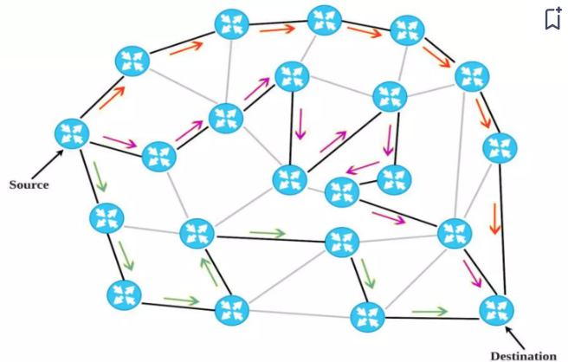
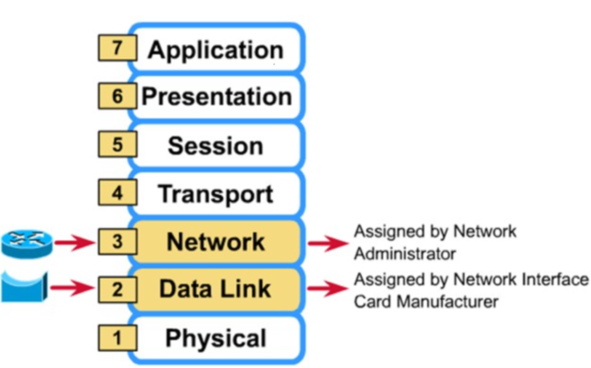
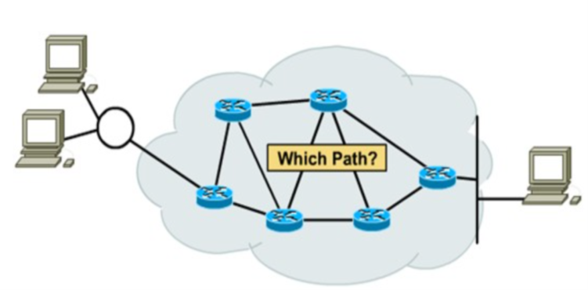
Routing Algorithm
Routing: The process of selecting best path among the various options available.
It is of various types: Static, Dynamic and Default. Routers will maintain intelligence of the network topology and forward packets based on destinations, selecting the best path across that topology.
Figure: 1 Source to destination Delivery of packets across different networks
Figure: 2 Router and Bridge
Figure: 3 Path Determination

Slide 4
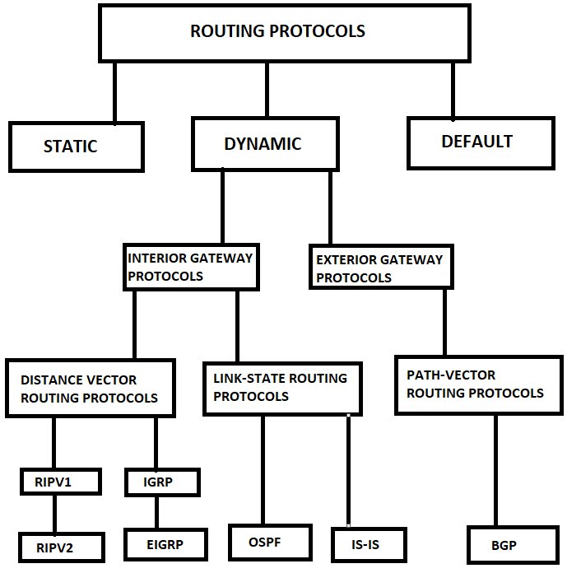
Types of Routing Protocols
Figure: 4 Routing Protocol Classification

Slide 5
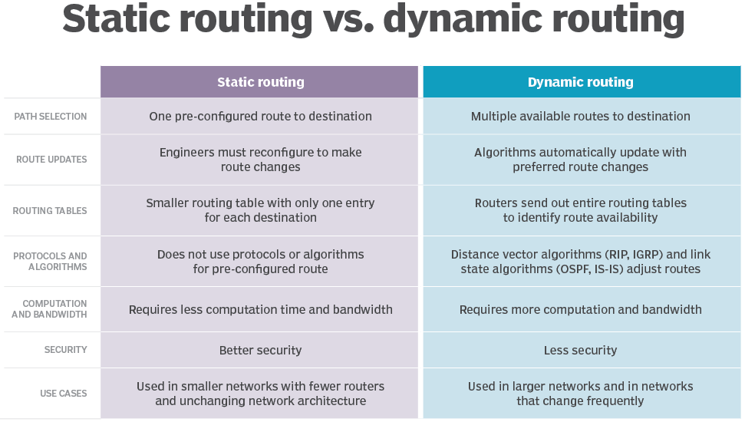
Static vs Dynamic Routing

Slide 6
Static vs Dynamic Routing
Static vs. dynamic routes
Static routes:
For hiding parts of an internetwork.
To test a particular link in a network.
For maintaining routing tables whenever there is only one path to a destination network.
Dynamic routes:
Maintenance of routing table.
Timely distribution of information in the form of routing updates.
Relies on routing protocol to share knowledge.
Routers can adjust to changing network conditions.

Slide 7
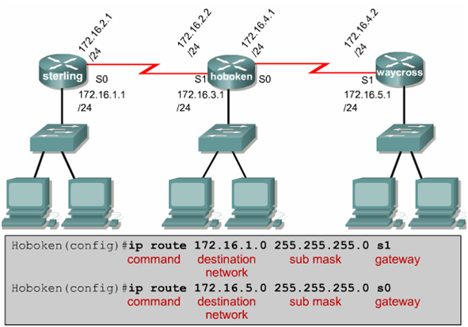
Static Routing:Configuration
Figure: 5 Static Routes built by using IP Route Command

Slide 8
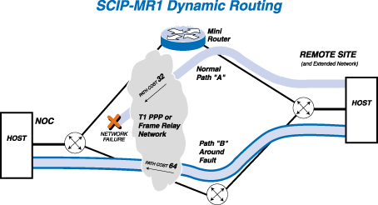
Dynamic Routing
Dynamic Routing is a network routing procedure that facilitates the routers to pick and choose the routing paths depending on the network structure’s logical changes in real-time. This is opposite to the typical traditional static network routing.
Figure: 6 SCIP-MR1 Dynamic Routing

Slide 9
Dynamic Routing
Dynamic routing, sometimes called adaptive routing, is more complex than static routing because it creates more possible routes to send packets across a network. Dynamic routes are typically used in larger, fluid networks where static routes would be cumbersome to maintain and frequently reconfigure. Because dynamic routing is more complicated, it consumes more bandwidth than static routing..
Dynamic routing uses algorithms to compute multiple possible routes and determine the best path for traffic to travel through the network. It uses two types of complex algorithms: distance vector protocols and link state protocols..
Both distance vector and link state protocols create a routing table within the router that includes an entry for each possible destination of a network, group of networks or specific subnet. Each entry specifies which network connection to use to send out a received packet.

Slide 10
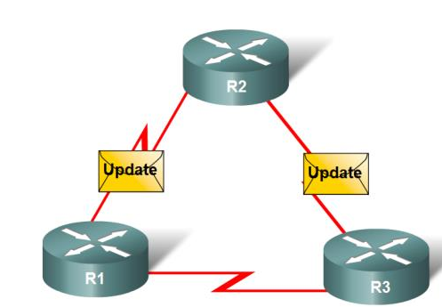
Dynamic Routing
Functions of Dynamic Routing Protocols:-
Dynamically share information between routers.
Automatically update routing table when topology changes.
Determine best path to a destination.
Figure: 7 Routers Dynamically Pass Updates

Slide 11
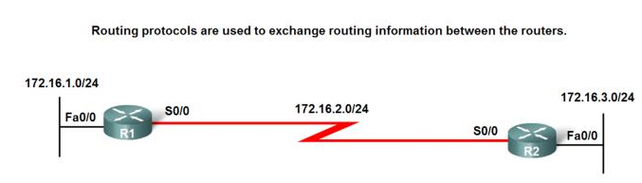
Dynamic Routing
The purpose of dynamic routing protocols includes the following:
Discovery of remote networks
Maintaining up-to-date routing information
Choosing the best path to destination networks
Ability to find a new best path if the current path is no longer available
Figure: 8 Routing Protocol Operation

Slide 12
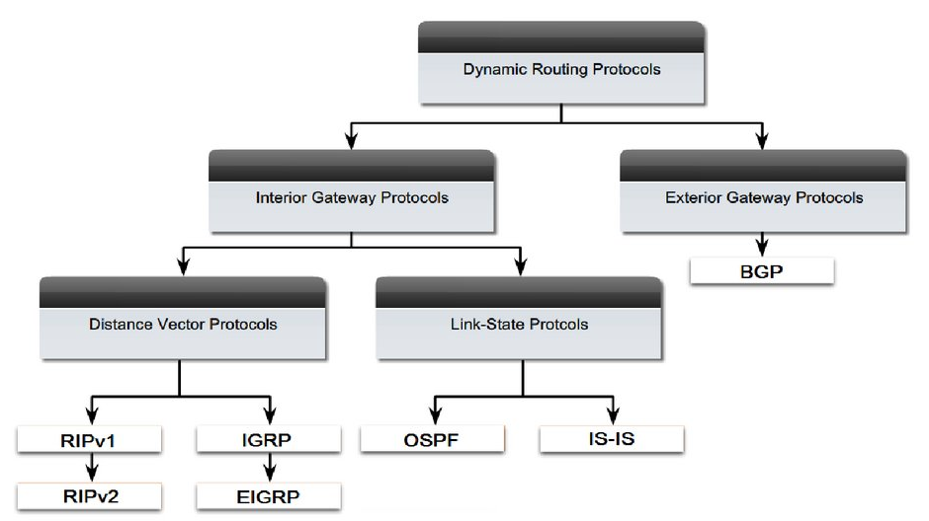
Dynamic Routing : Classifying
Classifying Routing Protocols
Dynamic routing protocols are grouped according to characteristics. Examples include:
RIP
IGRP
EIGRP
OSPF
IS-IS
BGP
Figure: 9 Dynamic Routing Protocols
Autonomous System is a group of routers under the control of a single authority.

Slide 13
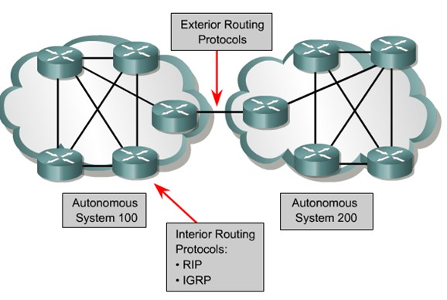
Dynamic Routing : IGP & EGP
Types of routing protocols:
- Interior Gateway Protocols (IGP)
- Exterior Gateway Protocols (EGP)
Classifying Routing Protocols
Interior Gateway Routing Protocols (IGP) –
Used for routing inside an autonomous system & used to route within the individual networks themselves –
Examples: RIP, EIGRP, OSPF
Exterior Routing Protocols (EGP)
Used for routing between autonomous systems
Example: BGPv4
Figure: 10 IGP vs. EGP Routing Protocols

Slide 14
IGRP & EIGRP
Cisco proprietary.
Interior Gateway Protocol.
Distance Vector Protocol.
Metric is compose of bandwidth, load, delay and reliability.
Maximum number of hops is 255.
Updates every 90 seconds.
EIGRP is an advanced version of IGRP, that is hybrid routing protocol.
Classification #2: IGP and EGP
Dynamic routes.
Interior Gateway Protocols (RIP, IGRP, EIGRP, OSPF):
Be used within an autonomous system, a network of routers under one administration, like a corporate network, a school district's network, or a government agency's network.
Exterior Gateway Protocols (EGP, BGP):
Be used to route packets between autonomous systems.

Slide 15
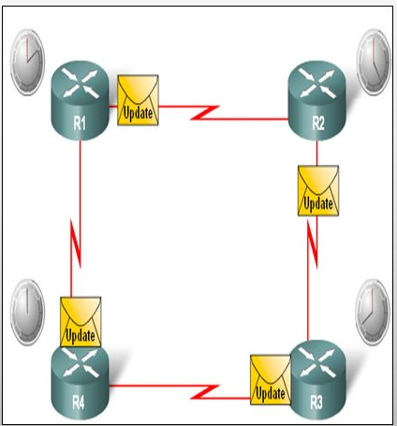
Distance Vector Routing
The least-cost route between any two nodes is the route with minimum distance.
Each node maintains a vector(table) of minimum distances to every node.
The table at each node also guides the packets to the desired node by showing the showing the next hop routing.
Example: Assume each node as the cities. Lines as the roads connecting them.
Figure: 11 Distance Vector Routing
Distance Vector Routing Protocols
Characteristics
Periodic updates
Triggered updates
Exchange information with Neighbors
Entire routing table is included with routing update

Slide 16
Distance Vector Routing
Characteristics of Distance Vector routing protocols:
Periodic updates
Periodic Updates sent at regular intervals (30 seconds for RIP). Even if the topology has not changed in several days,
Neighbors
The router is only aware of the network addresses of its own interfaces and the remote network addresses it can reach through its neighbors.
It has no broader knowledge of the network topology
Broadcast updates
Broadcast Updates are sent to 255.255.255.255.
Some distance vector routing protocols use multicast addresses instead of broadcast addresses.
Entire routing table is included with routing update
Entire Routing Table Updates are sent, with some exceptions to be discussed later, periodically to all neighbors.
Neighbors receiving these updates must process the entire update to find pertinent information and discard the rest.
Some distance vector routing protocols like EIGRP do not send periodic routing table updates.

Slide 17
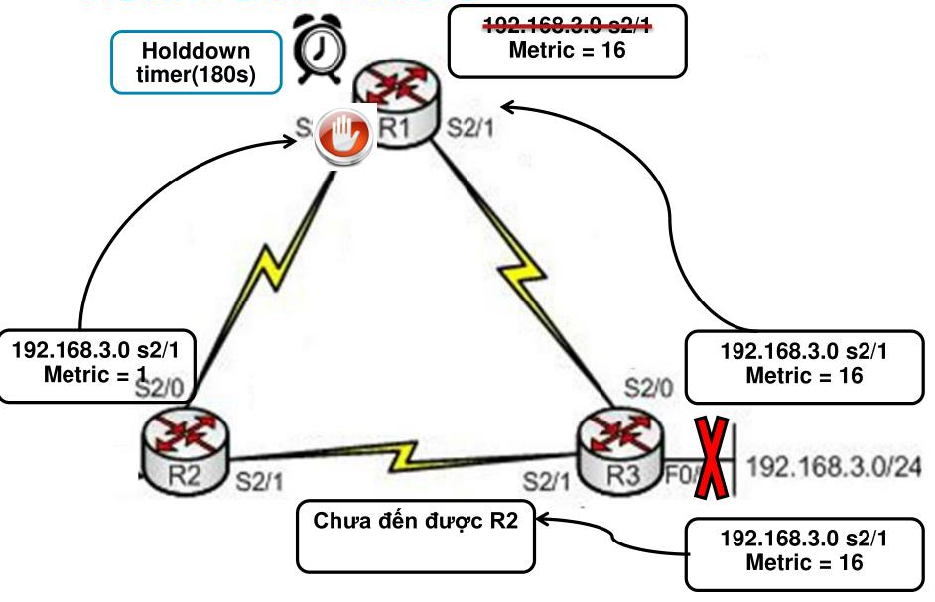
Hold-Down Timers
Figure: 12 Hold-Down Timers

Slide 18
Dijkstra Algorithm: Shortest path
What does it mean to be the shortest (or optimal) route?
Minimize mean packet delay
Maximize the network throughput
Minimize the number of hops along the path
Dijkstra algorithm:
Each node is labeled (in parentheses) with its distance from the source node along the best known path.
Initially, no paths are known, so all nodes are labeled with infinity.
As the algorithm proceeds and paths are found, the labels may change, reflecting better paths.
A label may be either tentative or permanent.
Initially, all labels are tentative.
When it is discovered that a label represents the shortest possible path from the source to that node, it is made permanent and never changed thereafter.
Now lets see the algorithm which describes this procedure to develop shortest path from source to destination.

Slide 19
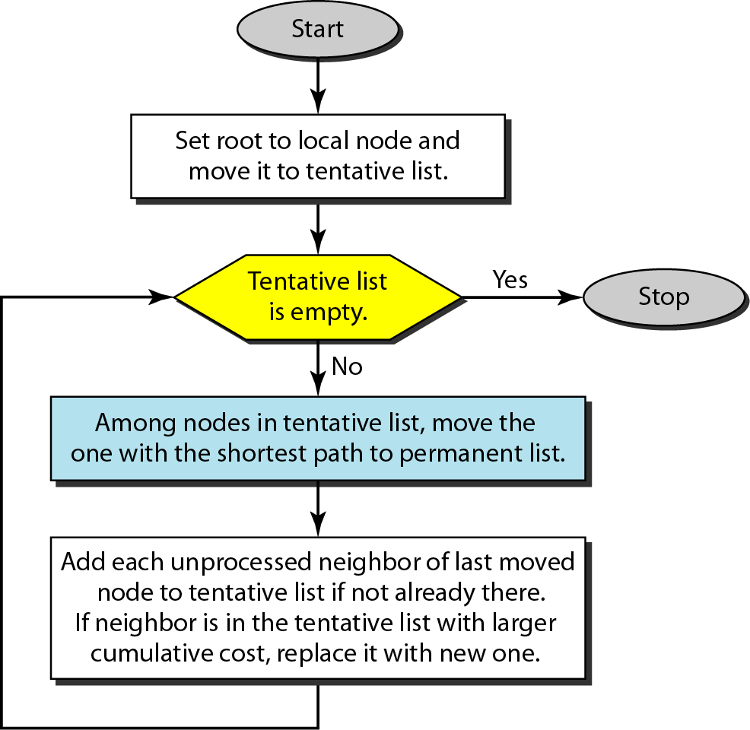
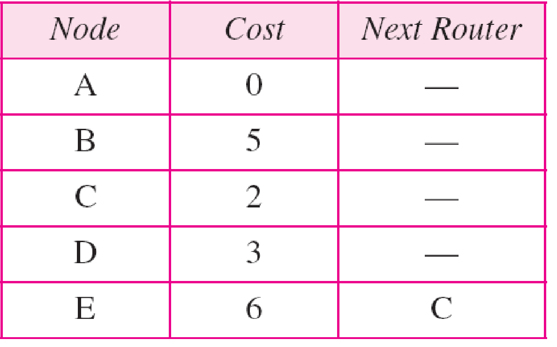
Dijkstra Algorithm
Routing table for node A
Figure: 13 Dijkstra Algorithm

Slide 20
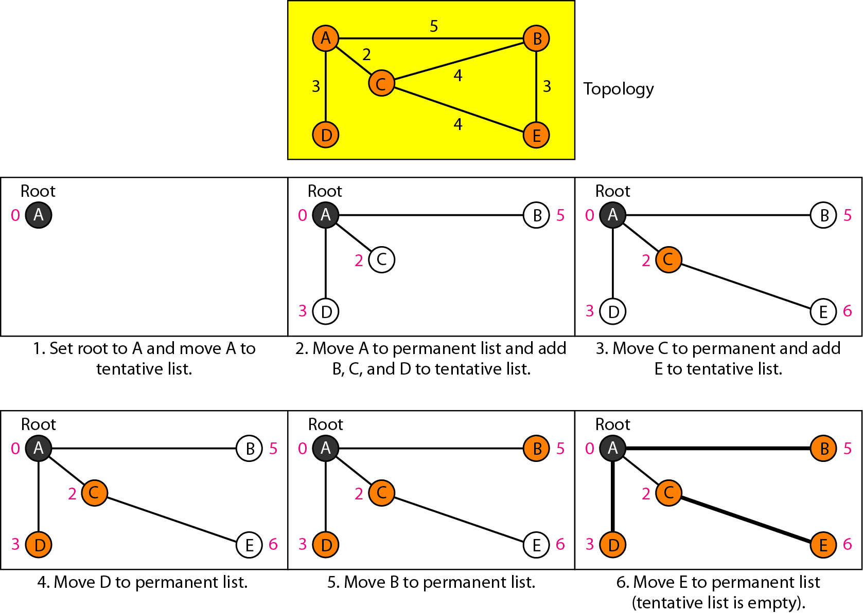
Example of formation of shortest path tree
Figure: 14 Shortest Path Tree

Slide 21
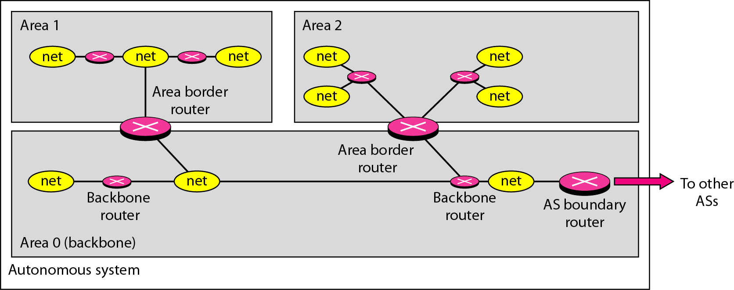
Areas in an autonomous system
Figure: 15 Areas in an autonomous system

Slide 22
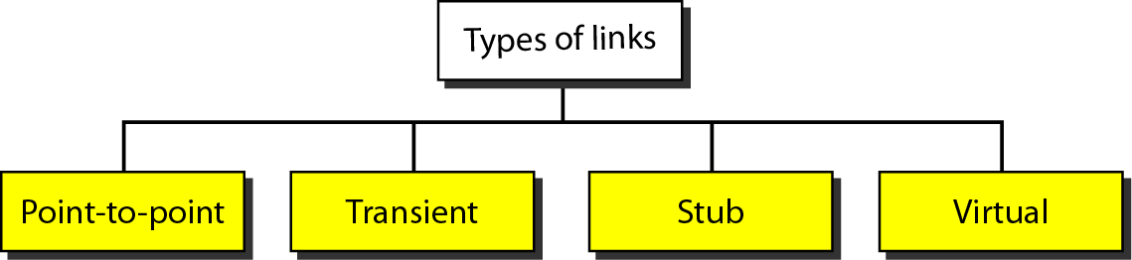
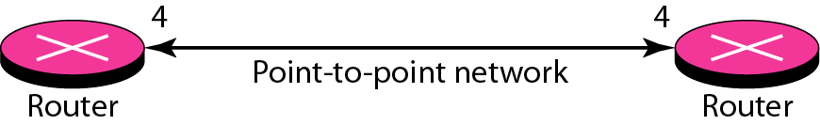
Types of links
Figure: 16 Links Classification
Figure: 17 Point-to-Point Link

Slide 23
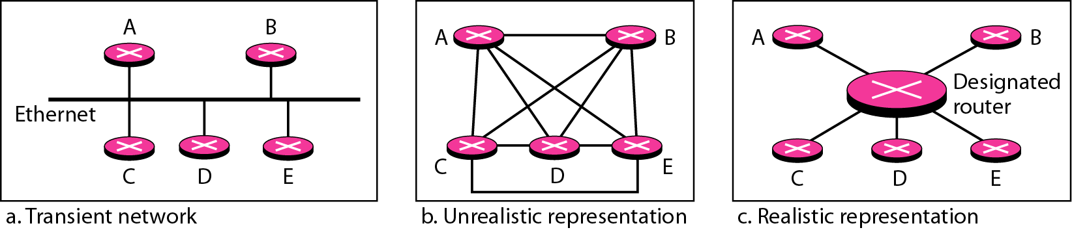
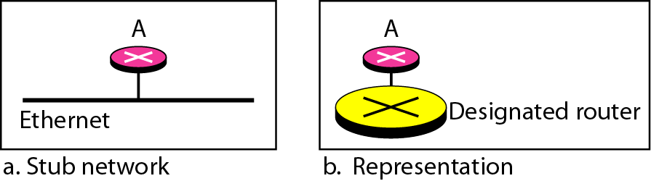
Contd..
Figure: 18 Transient Link
Figure: 19 Stub Link

Slide 24
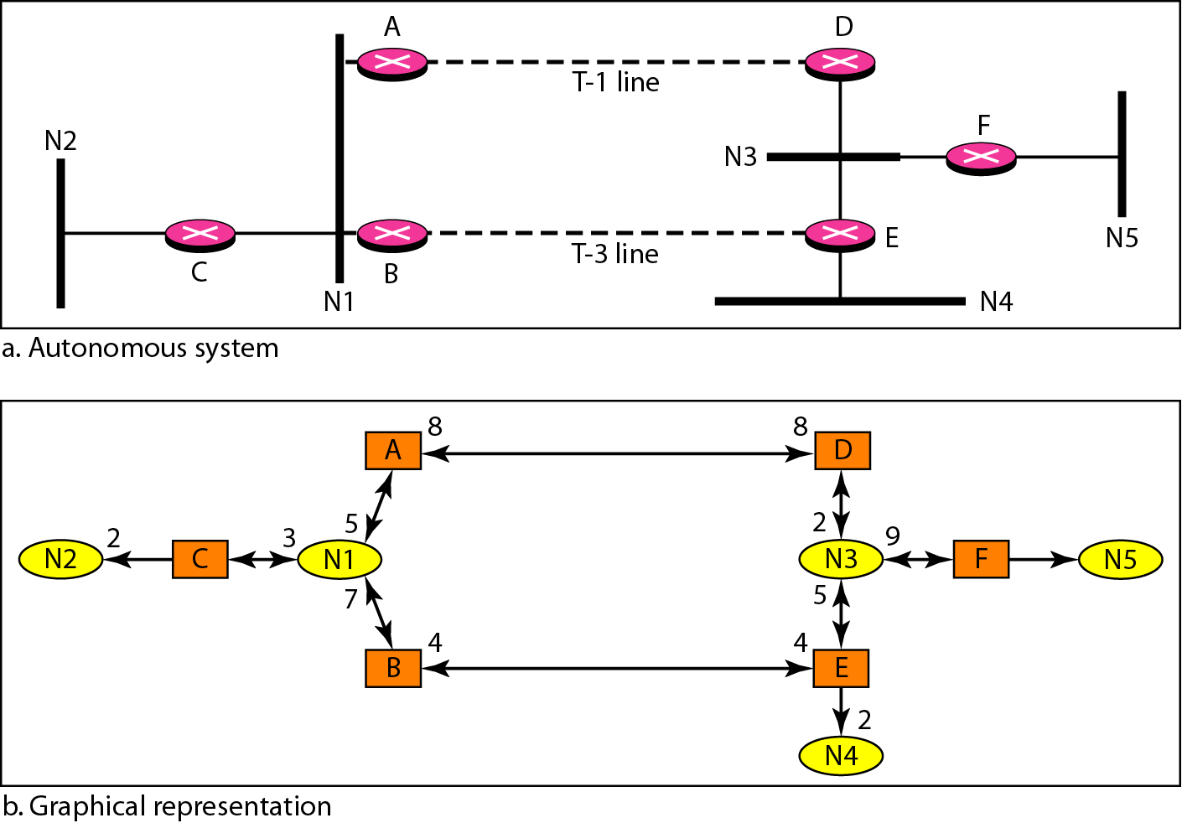
Example of an AS and its graphical representation in OSPF
Figure: 20 Autonomous System
OSPF
Open Shortest Path First.
Interior Gateway Protocol.
Link State Protocol.
Metric is compose of cost, speed, traffic, reliability, and security
Event-triggered updates.
Figure: 21 Graphical Representation

Slide 25
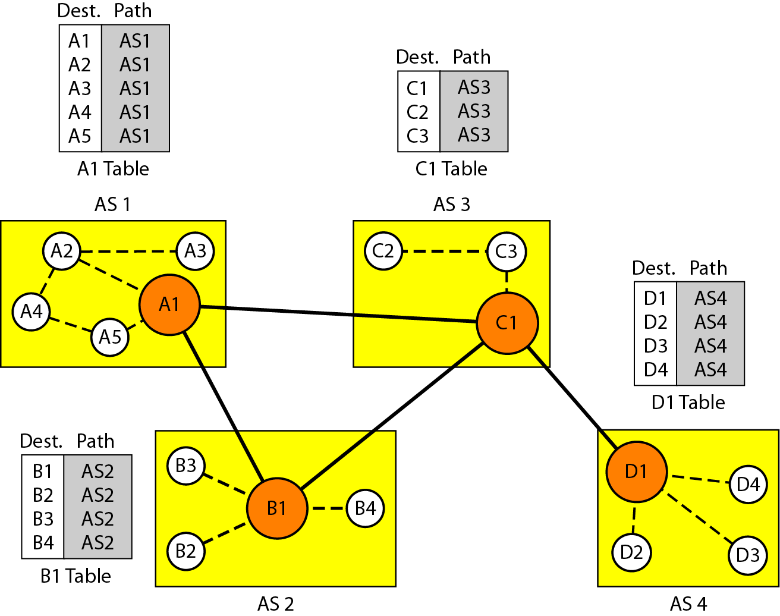
Path vector routing
Figure: 22 Initial routing tables in path vector routing

Slide 26
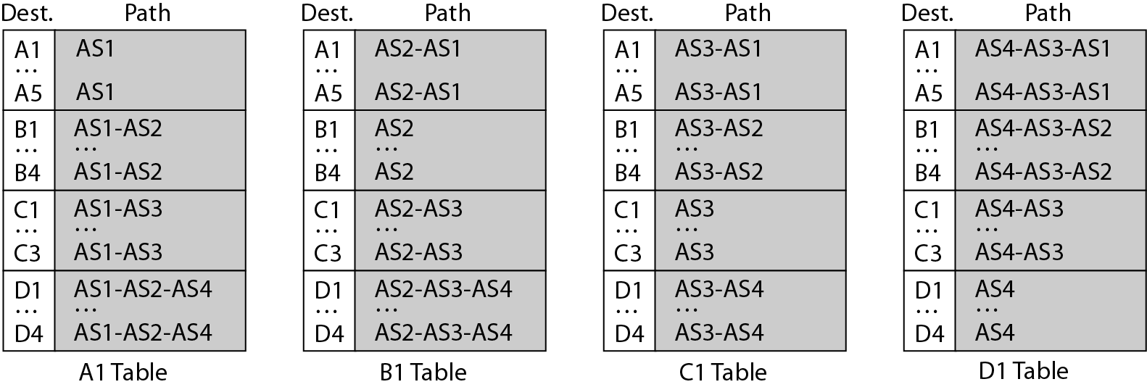
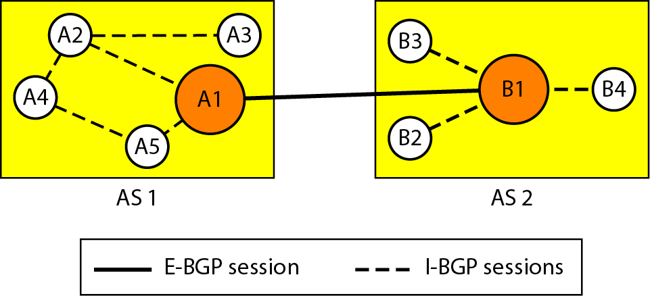
Stabilized tables for three autonomous systems
Figure: 23 Stabilized tables for three autonomous systems
Figure: 24 Internal & external BGP sessions

Slide 27
DVP (RIP) vs LSP (OSPF)
Classification #3: DVP and LSP
Distance-Vector Protocols (RIP, IGRP):
View network topology from neighbor's perspective.
Add distance vectors from router to router.
Frequent, periodic updates.
Pass copy of routing tables to neighbor routers.
Link State Protocols (OSPF):
Gets common view of entire network topology.
Calculates the shortest path to other routers.
Event-triggered updates.
Passes link state routing updates to other routers.
RIP
Interior Gateway Protocol.
Distance Vector Protocol.
Only metric is number of hops.
Maximum number of hops is 15.
Updates every 30 seconds.
Doesn’t always select fastest path.
Generates lots of network traffic.

Slide 28
Practice Questions
Which of the following routes may be found in a routing table? (Choose all that apply.)
directly connected networks
static routes
dynamic routing protocol routes
default route
What action will a router take on a packet with a destination IP address that is on a remote network?
It will forward the packet directly to the device with the destination IP address of the packet.
It will forward the packet to a next-hop router.
It will forward the packet to an Ethernet switch.
It will drop the packet.
What type of routing is typically used with a stub network?
static routes
dynamic routing protocol

Slide 29
Practice Questions
True or False? A default route can only be a static route.
True
False
Which routing table principle is not correct?
Every router makes its decision alone, based on the information it has in its own routing table.
The fact that one router has certain information in its routing table does not mean that other routers have the same information.
Routing information about a path from one network to another also provides routing information about the reverse, or return, path.
Which type of routing automatically adapts to topology changes?
static routes
dynamic routing protocols
both static routes and dynamic routing protocols
What term is used to describe routing over two or more paths to a destination with equal cost metrics?
equal path selection
oqual packot forward
equal cost load balancing
cqual cost routing

